Slide 1
Vircon32 system
( operated by users )
inputs
Vircon32
console
Power & Reset
Gamepad
outputs
Pad port 1
Gamepad
Video output
Screen
Pad port 2
Gamepad
Pad port 3
Audio output
Speakers
Gamepad
Pad port 4
Cartridge slot
Card slot
removable storage
Cartridge
Memory Card

Slide 2
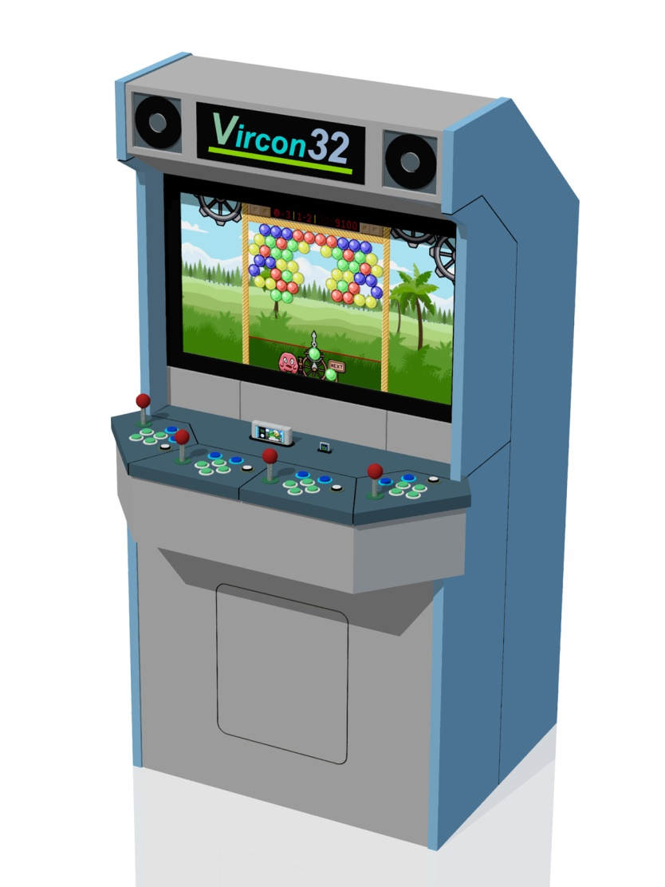
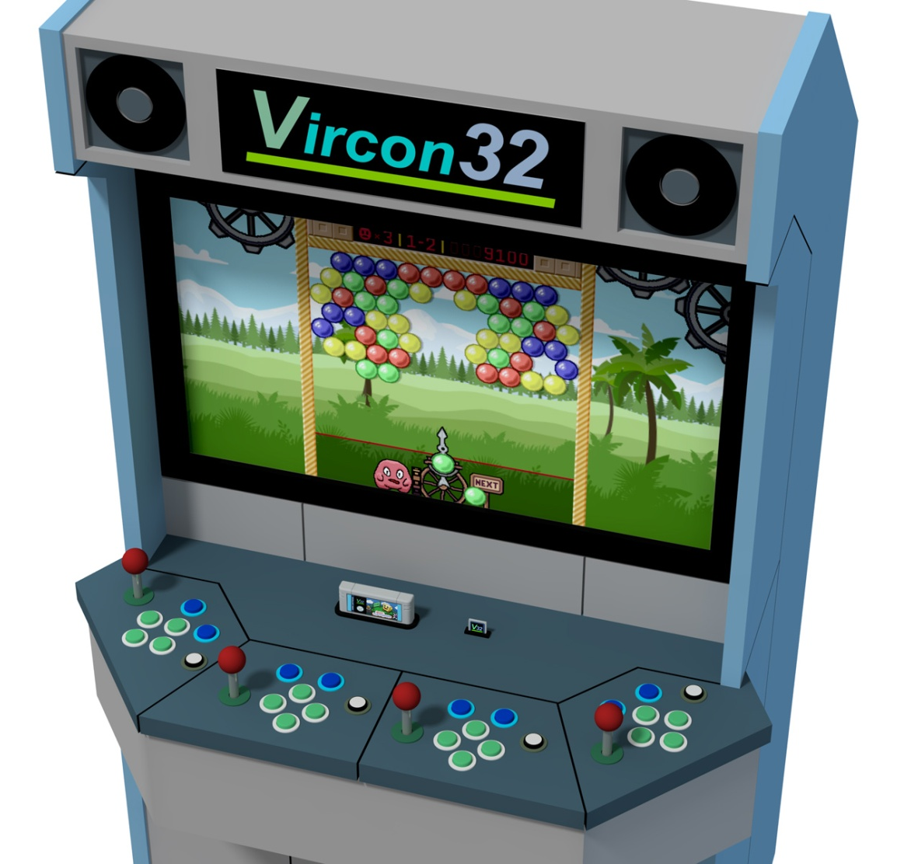

Slide 3
L
R

Slide 4
–
(center)
+
d-pad
Neutral position
(no user action)
housing
sphere
springs
switches
Force
Direction pressed
(user applies force)
Direction [ – ]
becomes pressed
Direction [ + ] can only be pressed by releasing [ – ]

Slide 5
640 pixels
pixel
(0, 0)
360
pixels
pixel
(639, 359)

Slide 6
L
R

Slide 7
Cartridge
Program ROM
(words)
Video ROM
(images)
Audio ROM
(sounds)
Memory card
Storage RAM
(words)

Slide 8
Cartridge
Program ROM
(words)
connection mechanism
Connector
Video ROM
(images)
Audio ROM
(sounds)
Memory card
Storage RAM
(words)
connection mechanism
Connector

